Slide 1
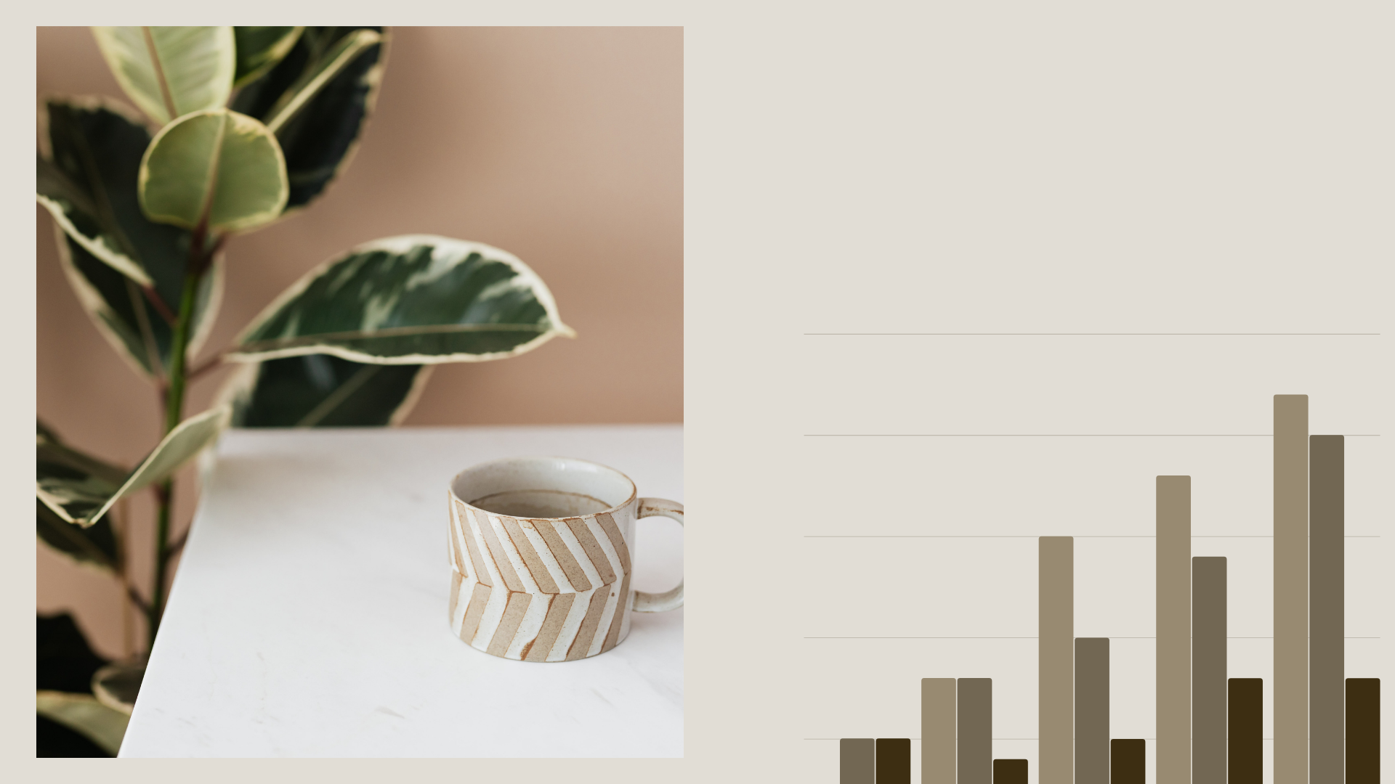
Visualization with ggplot2

Slide 2
Visualization with ggplot2
Basic coding of ggplot2
Dealing with layers
Dealing with multiple graphs

Slide 3
What is ggplot2?
R package for creating graphics
> install.packages("ggplot2")
> library(ggplot2)

Slide 4
How to play?
There are 3 steps to make a simple plot
Call for a function
ggplot2()
Select graphical type
Define X and/or Y

Slide 5




geom_bar geom_boxplot
geom_line
geom_smooth
and so on...
How to play?
There are 3 steps to make a simple plot
geom_point
Call for a function
Select graphical type
ggplot2()
+
Define X and/or Y

Slide 6
How to play?
There are 3 steps to make a simple plot
Call for a function
Select graphical type
geom_point
Define X and/or Y
ggplot2()
+
From your own needed
From your dataset

Slide 7
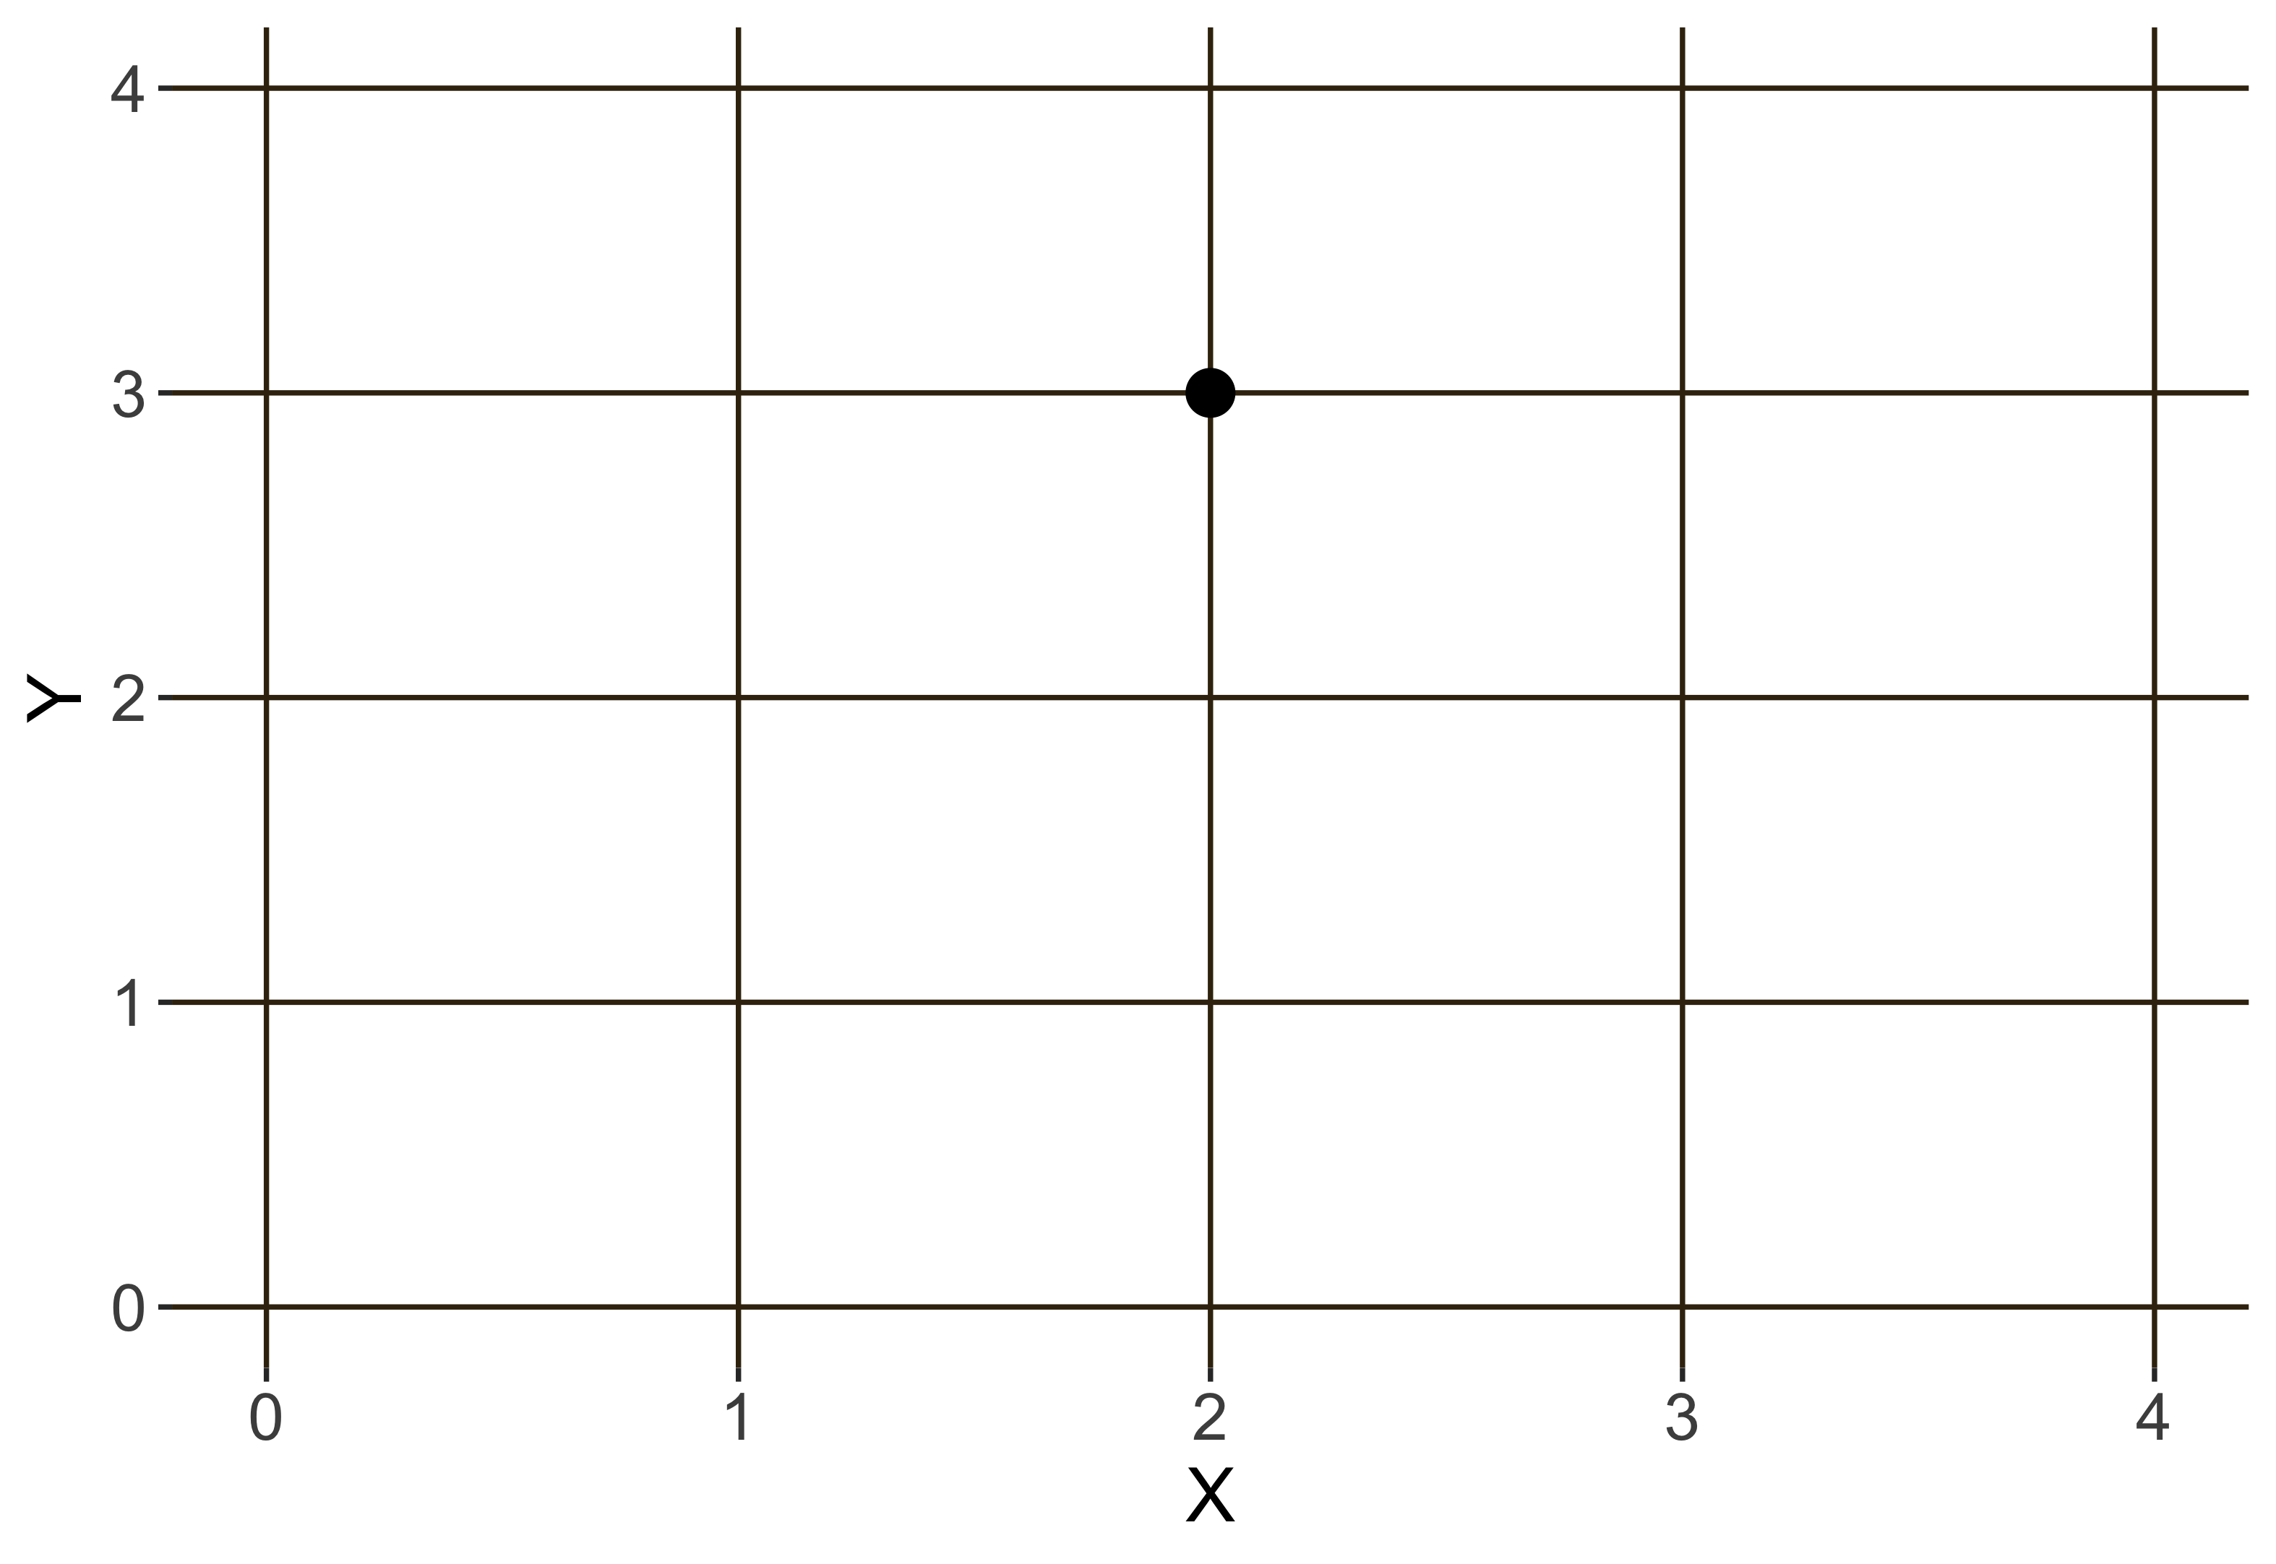
How to play?
There are 3 steps to make a simple plot
Call for a function
Select graphical type
Define X and/or Y
geom_point( aes(x=2, y=3) )
From your own needed
ggplot2()
+
From your dataset

Slide 8
Tips
There is dataset in based-R namely “iris”
> iris
How to play?
Petal.Length Petal.Width Species
There are 3 steps to make a simple plot
1.4 0.2 setosa
1.4 0.2 setosa
1.3 0.2 setosa
Call for a function
花瓣长度. 花瓣宽度 物种
Select graphical type
Define X and/or Y
From your own needed
From your dataset
ggplot2()
+
geom_point( data = Mat_data, aes(x= X , y= Y) )

Slide 9
Tips
There is dataset in based-R namely “iris”
> iris
How to play?
Petal.Length Petal.Width Species
There are 3 steps to make a simple plot
1.4 0.2 setosa
1.4 0.2 setosa
1.3 0.2 setosa
Call for a function
花瓣长度. 花瓣宽度 物种
Select graphical type
Define X and/or Y
From your dataset
ggplot2()
+
geom_point( data = Mat_data, aes(x= X , y= Y) )
X is used to predict Y
X 用于预测 Y

Slide 10
Tips
There is dataset in based-R namely “iris”
> iris
How to play?
Petal.Length Petal.Width Species
There are 3 steps to make a simple plot
1.4 0.2 setosa
1.4 0.2 setosa
1.3 0.2 setosa
Call for a function
花瓣长度. 花瓣宽度 物种
Select graphical type
X
Y
Define X and/or Y
From your dataset
ggplot()+ geom_point( data = iris,
aes(x= Petal.Length, y= Petal.Width) )

Slide 11
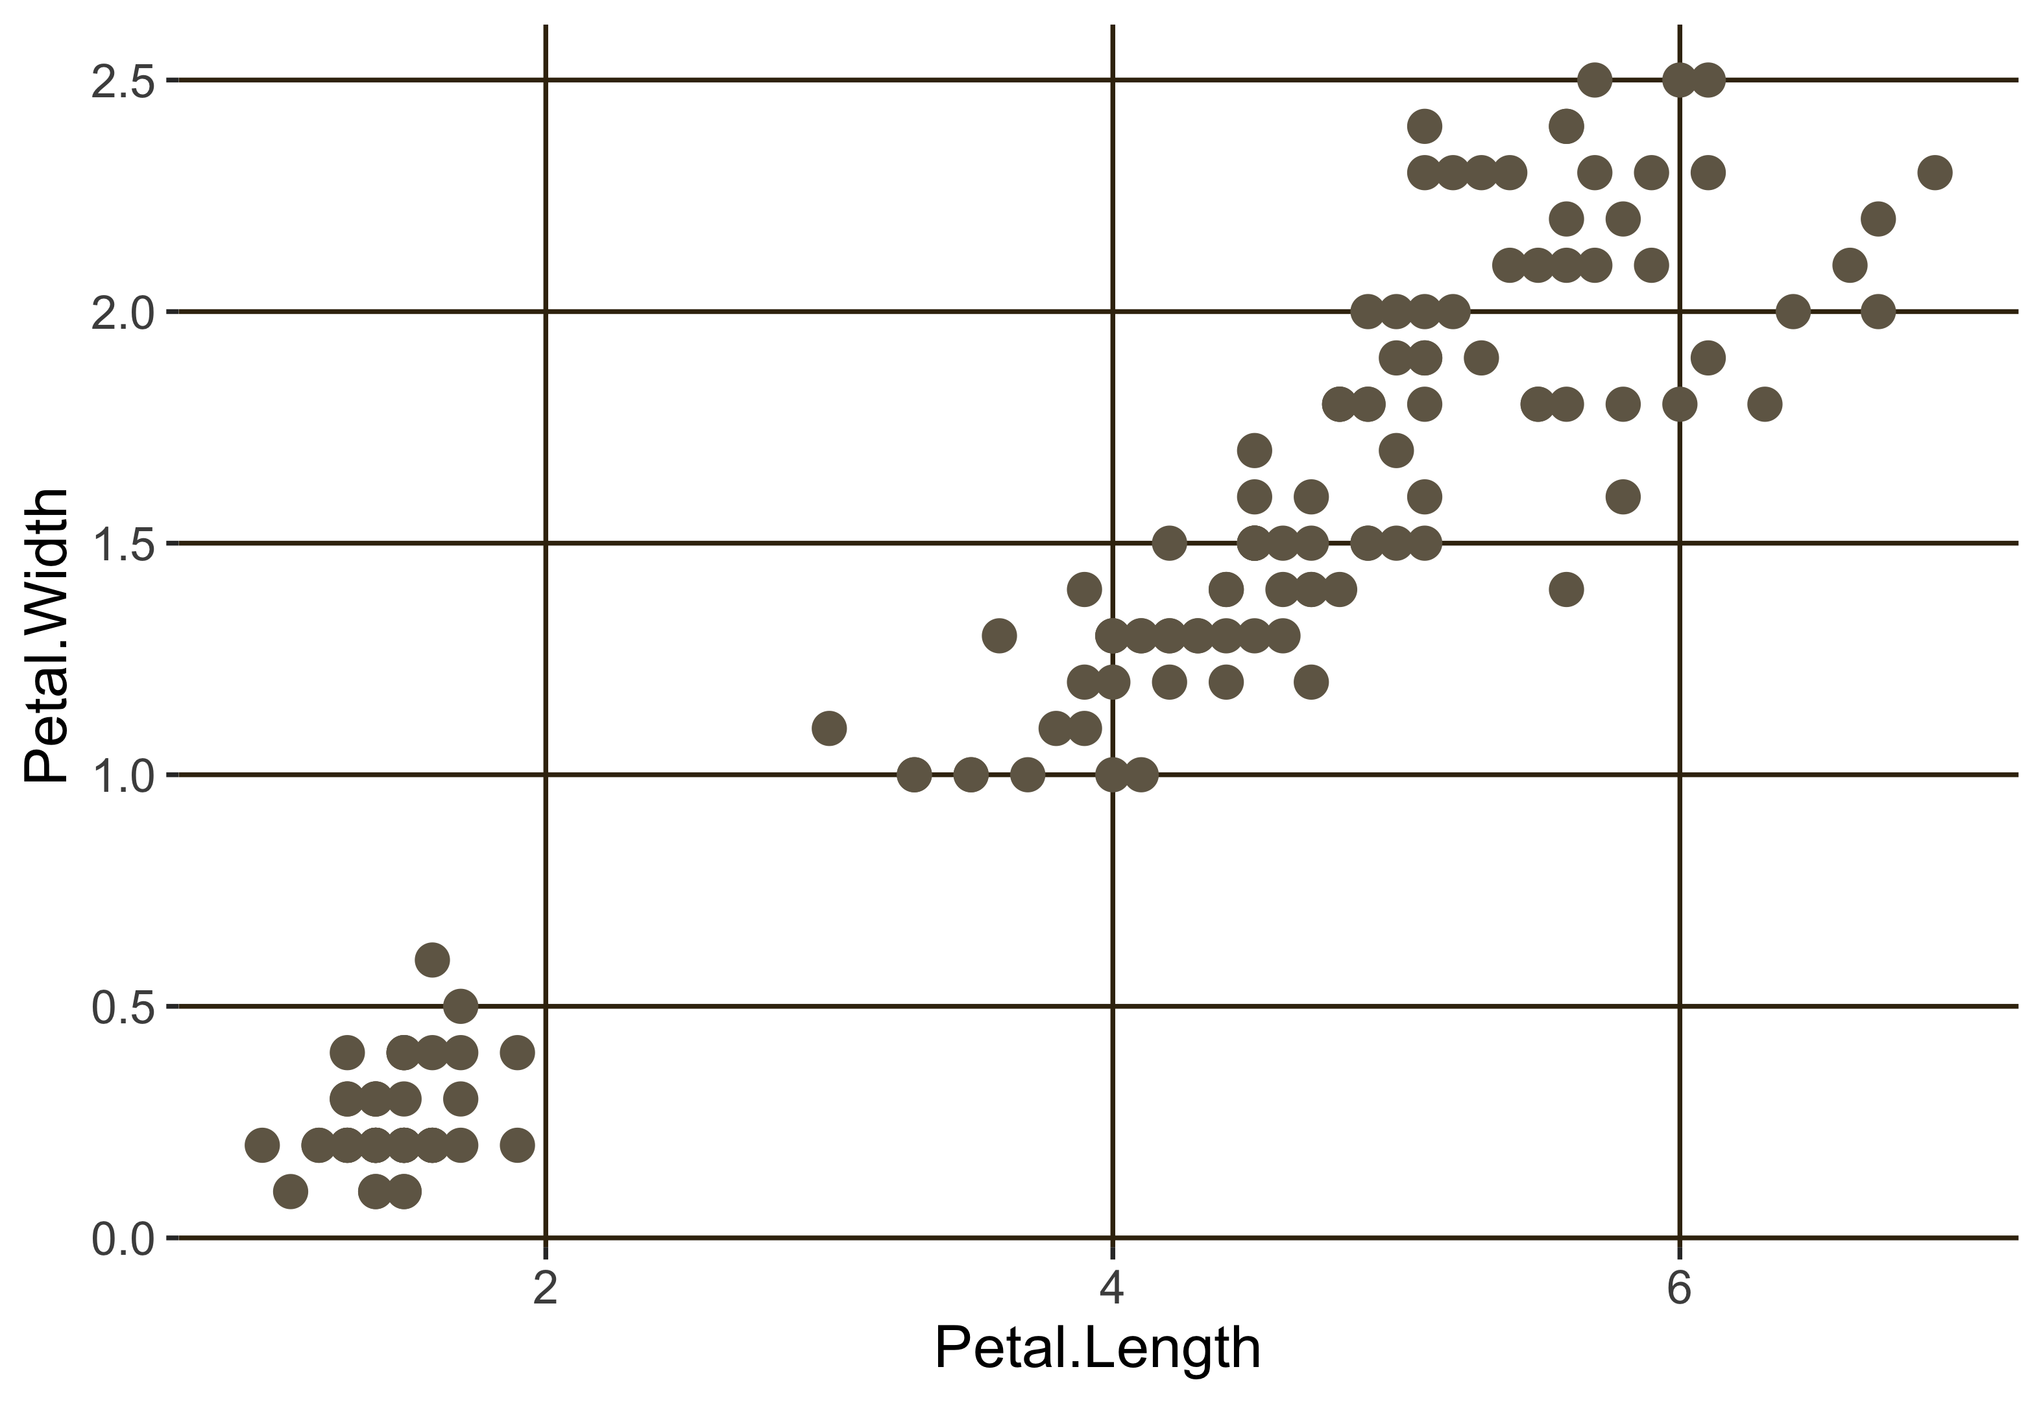
How to play?
There are 3 steps to make a simple plot
Call for a function
Select graphical type
Define X and/or Y
From your dataset
ggplot()+ geom_point( data = iris,
aes(x= Petal.Length, y= Petal.Width) )

Slide 12
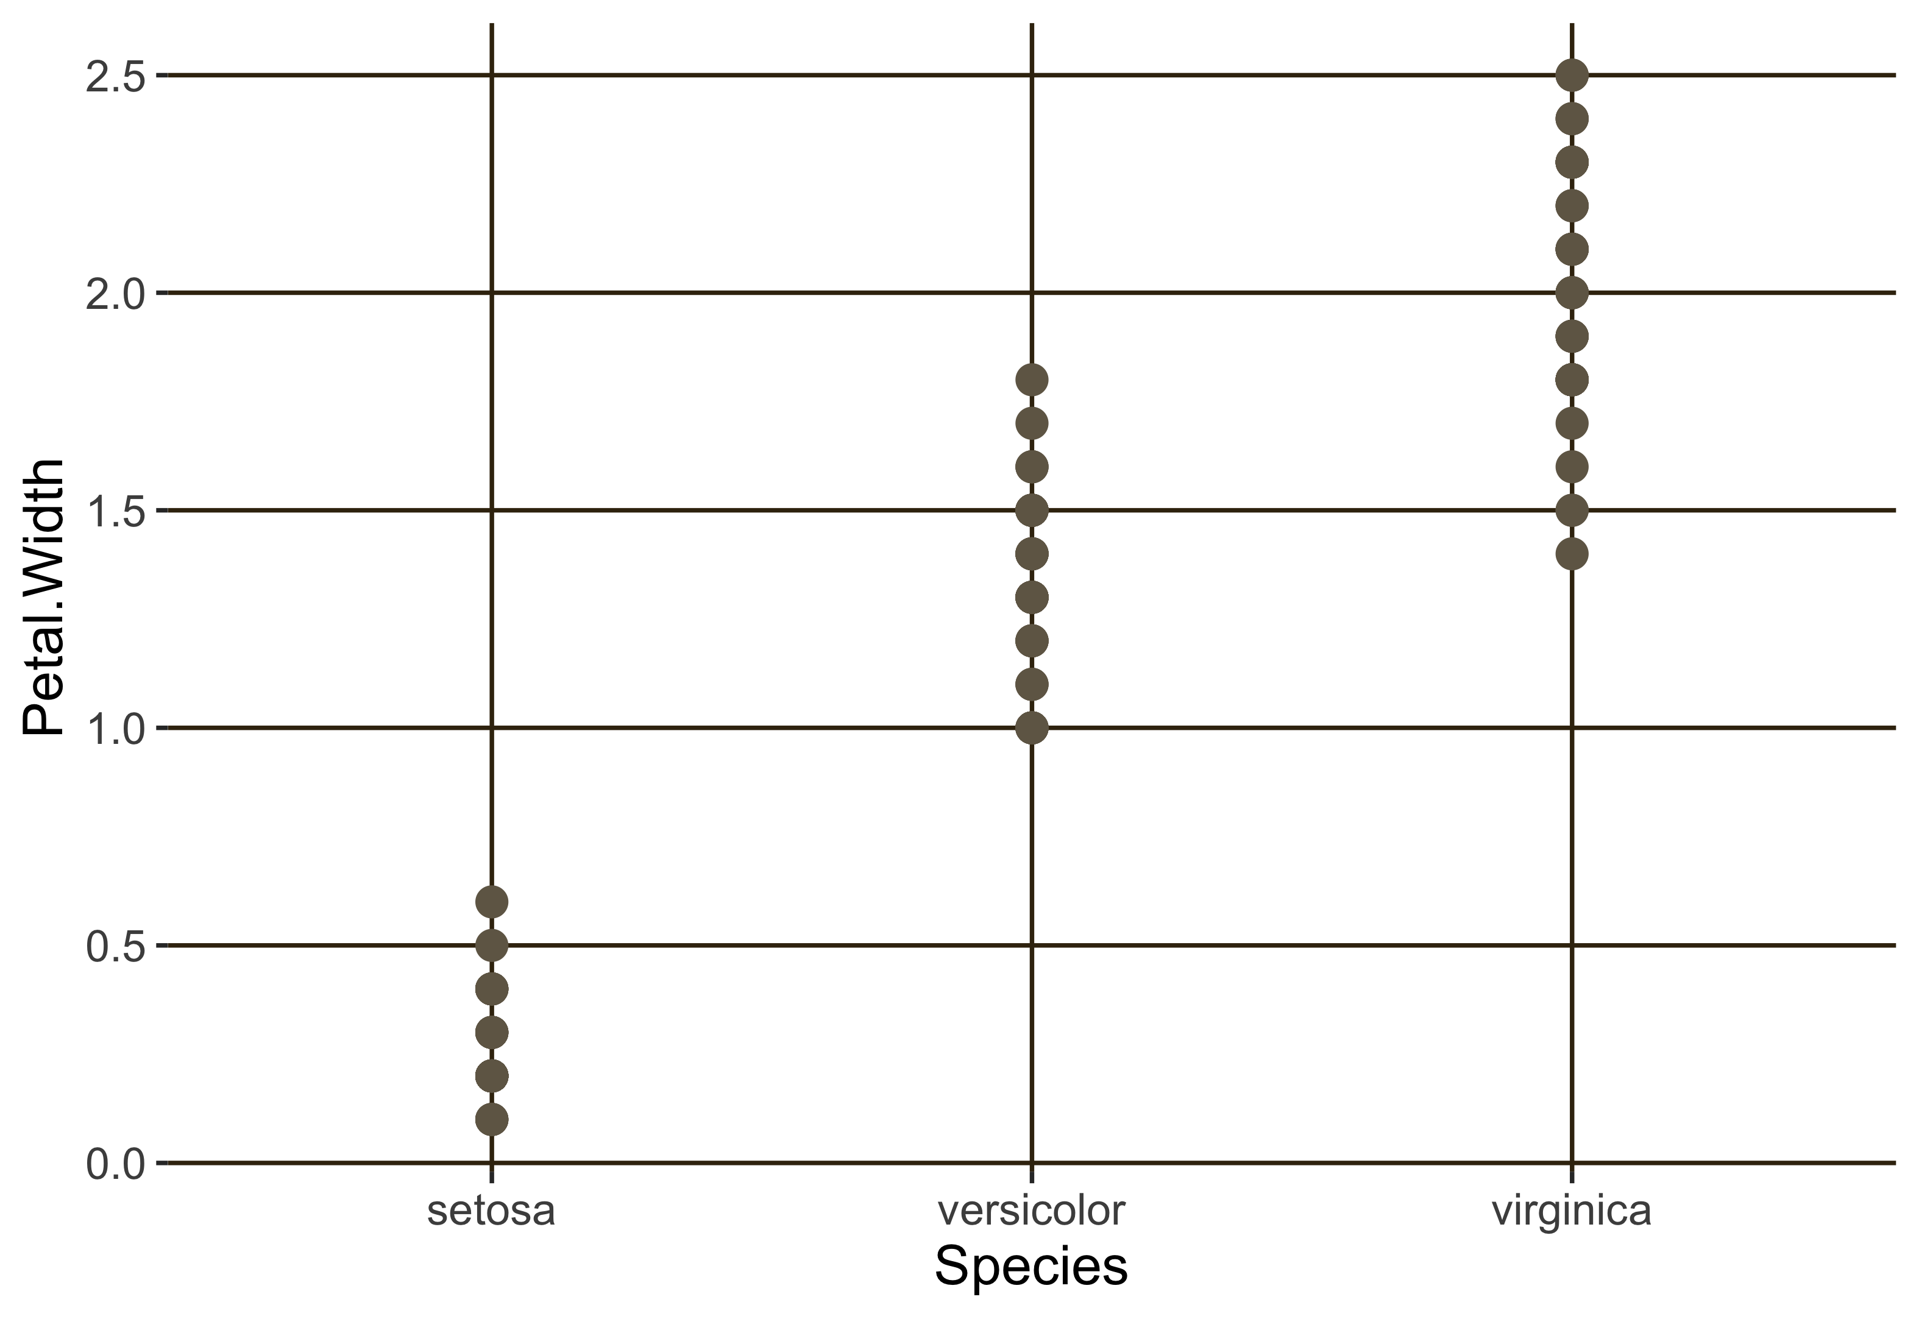
How to play?
There are 3 steps to make a simple plot
Call for a function
Select graphical type
Define X and/or Y
From your dataset
ggplot()+ geom_point( data = iris,
aes(x= Species, y= Petal.Width) )

Slide 13
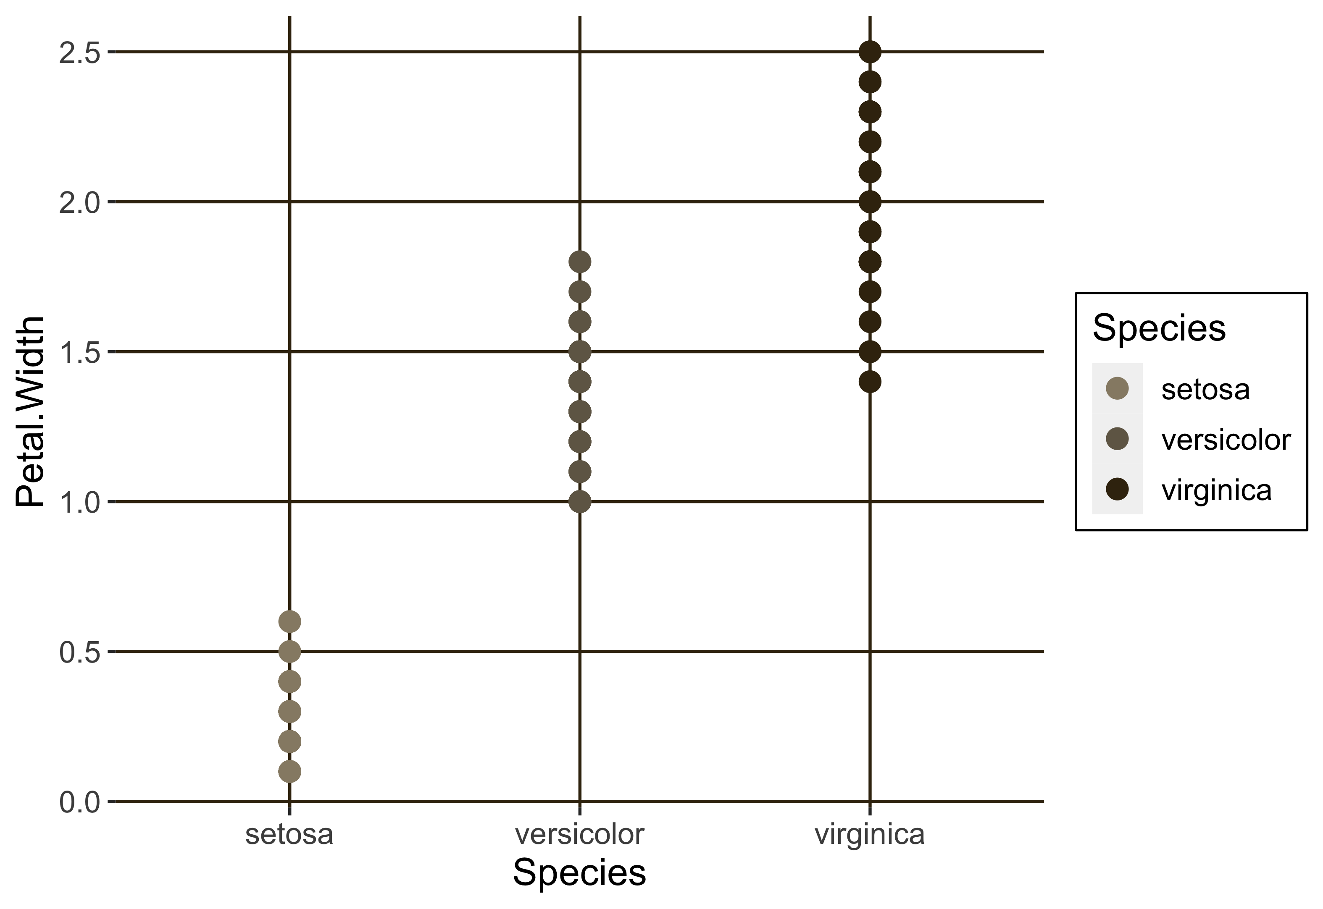
How to play?
There are 3 steps to make a simple plot
Call for a function
Select graphical type
Define X and/or Y
From your dataset
ggplot()+ geom_point( data = iris,
aes(x= Species, y= Petal.Width, color= Species) )
ggplot()+ geom_point( data = iris,
aes(x= Species, y= Petal.Width), color= “red”)

Slide 14
Title
Size, shape, color
ggtitle()
geom_point()
Axis label
Legend
xlab(), ylab()
theme()
Axis range
xlim(), ylim()
Axis, grid, background
theme()
> ggplot2() + geom_point(...) +
ggtitle(“My flower”)
+ ylab(“How fat of the flower (cm)”)

Slide 15
Title
Size, shape, color
ggtitle()
geom_point()
Axis label
Legend
xlab(), ylab()
theme()
Axis range
xlim(), ylim()
Axis, grid, background
theme()
> ggplot2() + geom_point( aes(x=, y=, ...), color=“black”, size=1, shape=1, alpha=0.5 ) +
ggtitle(“My flower”)
+ ylab(“How fat of the flower (cm)”)
+

Slide 16
Summary
3
2
components to build a simple plot
adjustments on graphical appearances
ggplot2() + geom_xxx( aes(...) )
geom_xxx(...) + other functions

Slide 17

Dealing with LAYERS

Slide 18
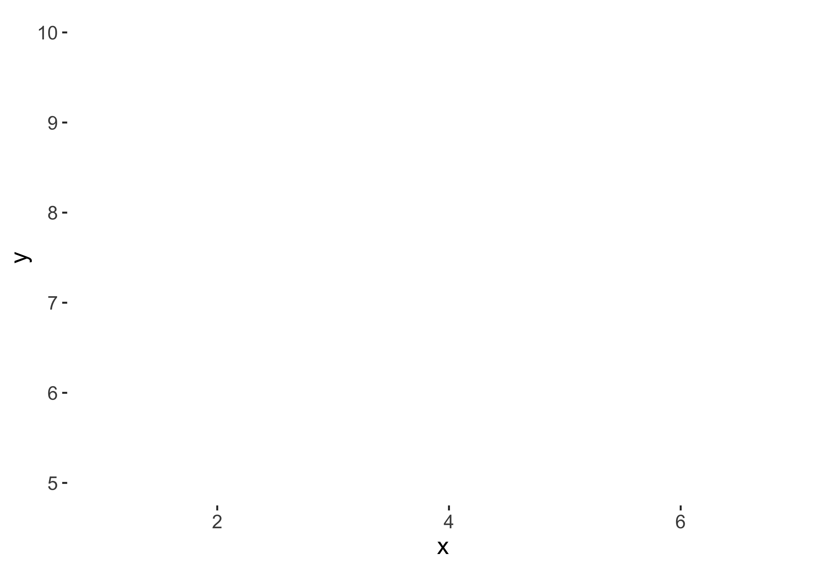
Mixing graphs
Just add subsequent “geoms”
ggplot()+ geom_point(data=MAT, aes(x1,y1))+
y
geom_point(data=Arisa, aes(x2,y2))+
geom_line(data= Arisa, aes(x2, y2))
x

Slide 19
Mixing graphs
Just add subsequent “geoms”
back
ggplot()+ geom_point(data=MAT, aes(x,y1))+
front
y
geom_point(data=Arisa, aes(x,y2))+
geom_line(data= Arisa, aes(x, y2))
x
Forward layers

Slide 20
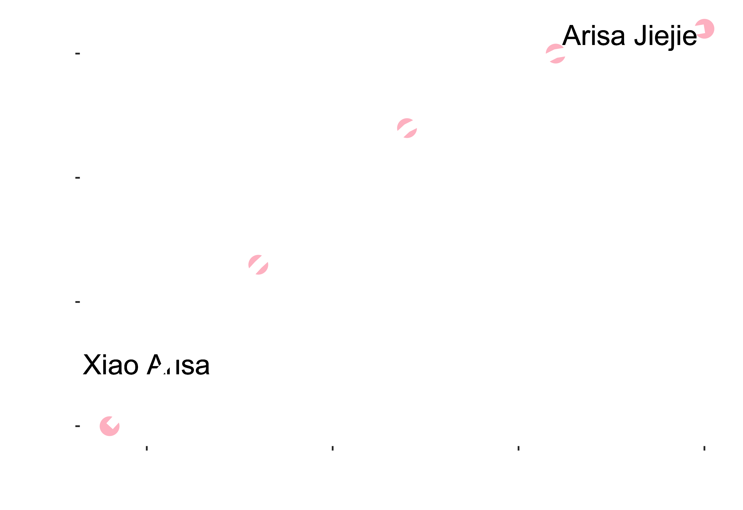
Mixing graphs
Just add subsequent “geoms”
> ggplot()+ geom_text(aes(x=5, y=110, label="Xiao Arisa”))+
geom_point(data=Arisa, aes(x=Age, y=Height))+
geom_line(data=Arisa, aes(x=Age, y=Height))+
geom_text(aes(x=18, y=163, label="Arisa Jiejie”)

Slide 21
Help!
Mixing graphs
Please help Arisa improving her developmental graph
Just add subsequent “geoms”
> ggplot()+ geom_text(aes(x=5, y=110, label="Xiao Arisa”))+
geom_point(data=Arisa, aes(x=Age, y=Height))+
geom_line(data=Arisa, aes(x=Age, y=Height))+
geom_text(aes(x=18, y=163, label="Arisa Jiejie”)

Slide 22
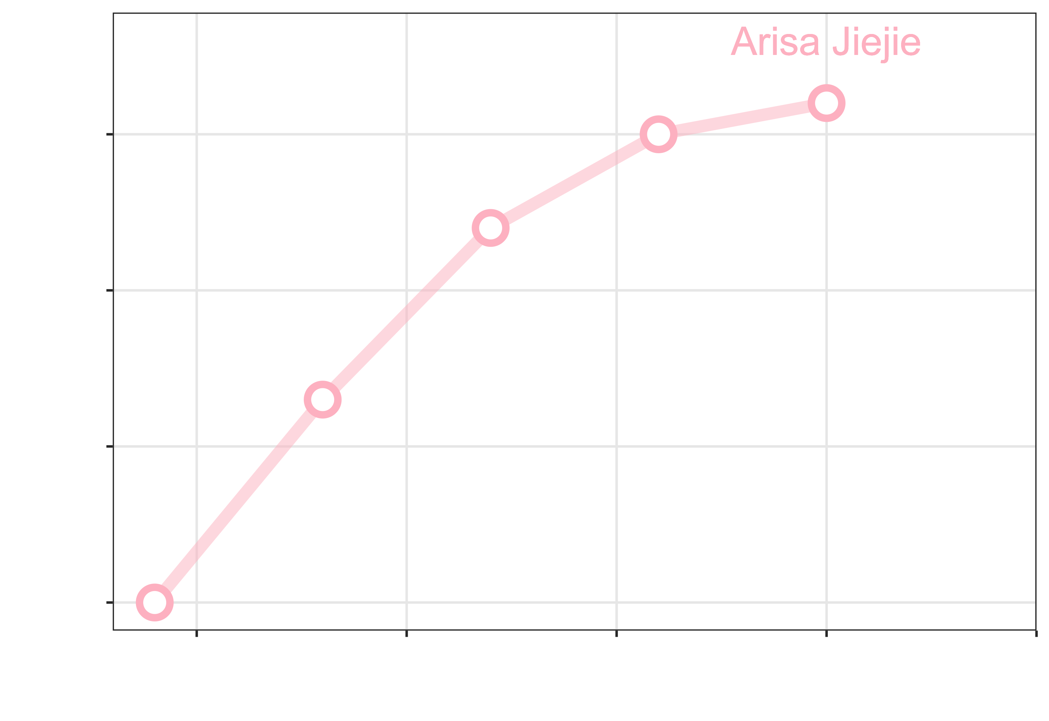
Tips
Mixing graphs
You can repeat a similar function to highlight the graph component!
Just add subsequent “geoms”
> ggplot()+
geom_line(data=Arisa, aes(x=Age, y=Height), color=“pink”, alpha=0.3)+
geom_point(data=Arisa, aes(x=Age, y=Height), color=“pink”, size=7)+
geom_point(data=Arisa, aes(x=Age, y=Height), color=“white, size=4)+ ...

Slide 23
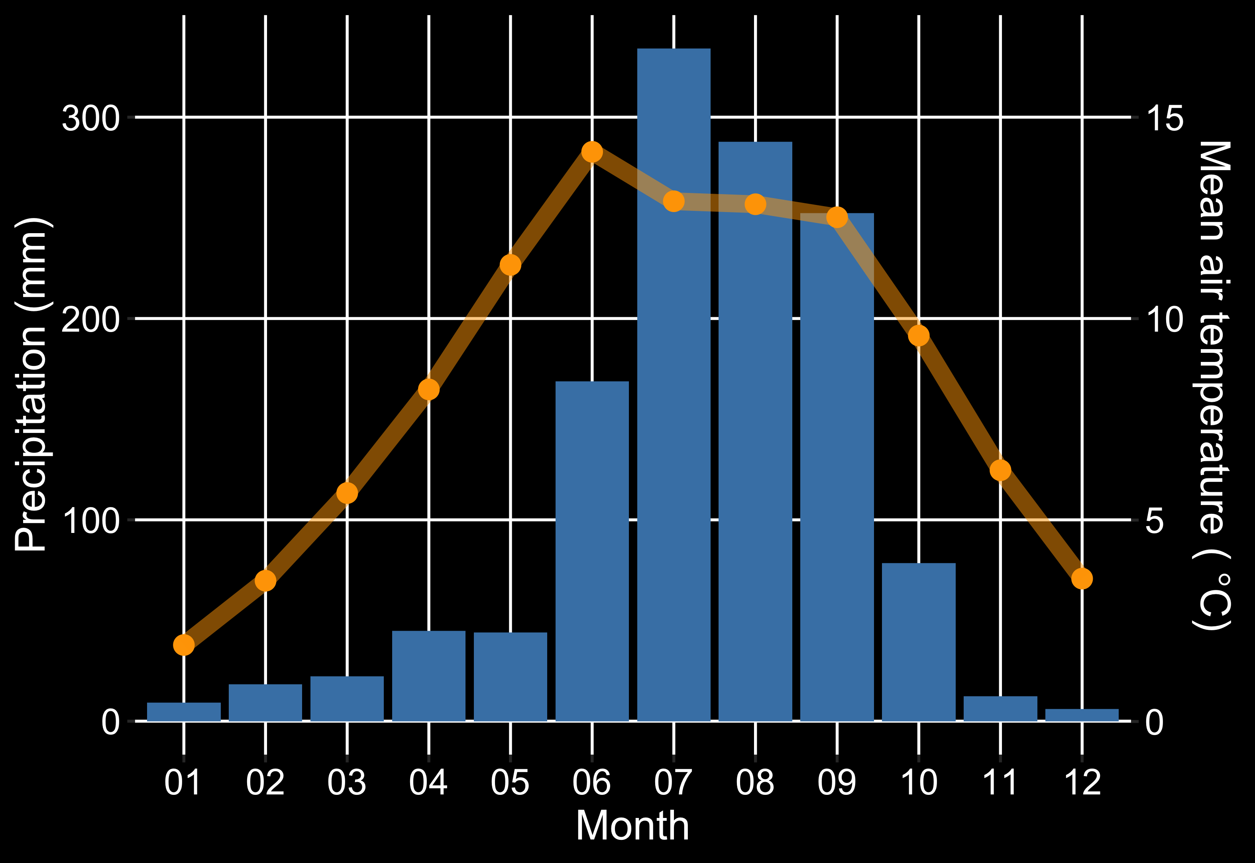
Mixing graphs
You’re almost able to do temperature-precipitation graph!
Dual Y-axis
> install.packages(“patchwork”)
> library(patchwork)

Slide 24
Common aes( )
If you are lazy, there is a way!
> ggplot()+
geom_line(data=Arisa, aes(x, y))+
geom_point(data=Arisa, aes(x, y))
> ggplot(data=Arisa, aes(x, y))+
geom_line()+
geom_point()

Slide 25
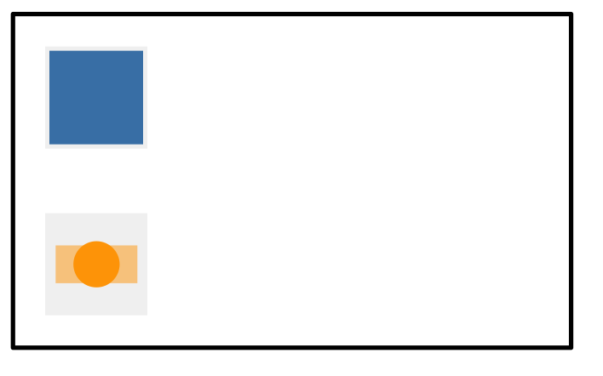
Tips
How the ggplot2’s factor legend works?

Slide 26
Tips
How the ggplot2’s factor legend works?
Wide format
Long format
Month Tair Precipitation
01 1.9 9.2
02 3.5 18.4
03 5.7 22.3
04 8.2 44.8
Month Parameter Value
01 Tair 1.9
02 Tair 3.5
01 Precipitation 9.2
02 Precipitation 18.4

Slide 27
Tips
How the ggplot2’s factor legend works?
Wide format
Long format
x y1 y2
x y
Month Tair Precipitation
01 1.9 9.2
02 3.5 18.4
03 5.7 22.3
04 8.2 44.8
Month Parameter Value
01 Tair 1.9
02 Tair 3.5
01 Precipitation 9.2
02 Precipitation 18.4
y1
Grouping
y2

Slide 28
Tips
How the ggplot2’s factor legend works?
Wide format
Long format
x y1 y2
x y
Month Tair Precipitation
01 1.9 9.2
02 3.5 18.4
03 5.7 22.3
04 8.2 44.8
Month Parameter Value
01 Tair 1.9
02 Tair 3.5
01 Precipitation 9.2
02 Precipitation 18.4
Allow 2 different graphical types
Provide grouping legend

Slide 29
Tips
How the ggplot2’s factor legend works?
Wide format
Long format
x y1 y2
x y
Month Tair Precipitation
01 1.9 9.2
02 3.5 18.4
03 5.7 22.3
04 8.2 44.8
Month Parameter Value
01 Tair 1.9
02 Tair 3.5
01 Precipitation 9.2
02 Precipitation 18.4
Allow 2 different graphical types
Provide grouping legend
geom_line( aes(x,y1) )+
geom_line( aes(x,y2) )+
geom_line( aes(x,y, group= Parameter) )+

Slide 30
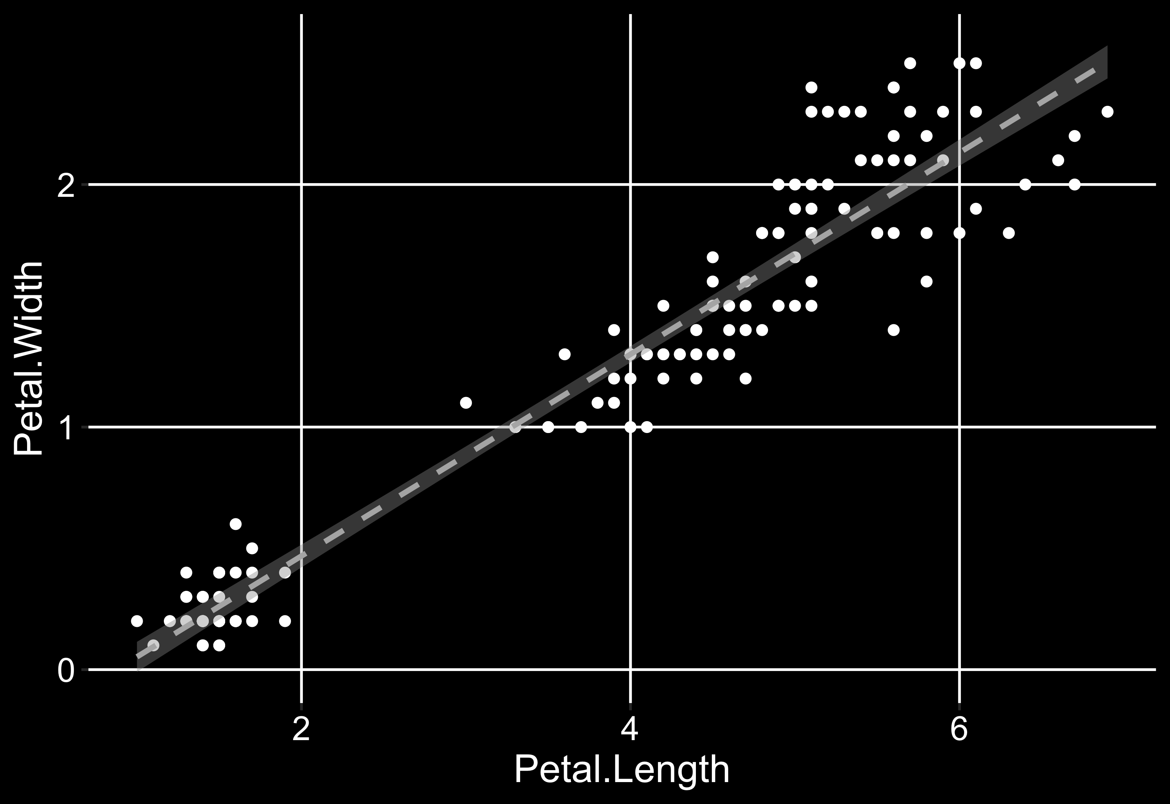
Trend line
Just another layer of statistics
Quick & convenient
geom_smooth(...)
Quick & flexible
stat_smooth(...)
传奇的!
data = data.frame(y=predict(model), x)
geom_line(data, ...)

Slide 31
Tips
stat_smooth(data, aes(x, y), method=“lm”, formula=“y~x”, se= TRUE, level=0.95, ...)
Trend line
Just another layer of statistics
lm glm gam loess
method =
y ~ x y ~ log(x)
y ~ poly(x, 2) y ~ s(x, bs = "cs")
formula =

Slide 32
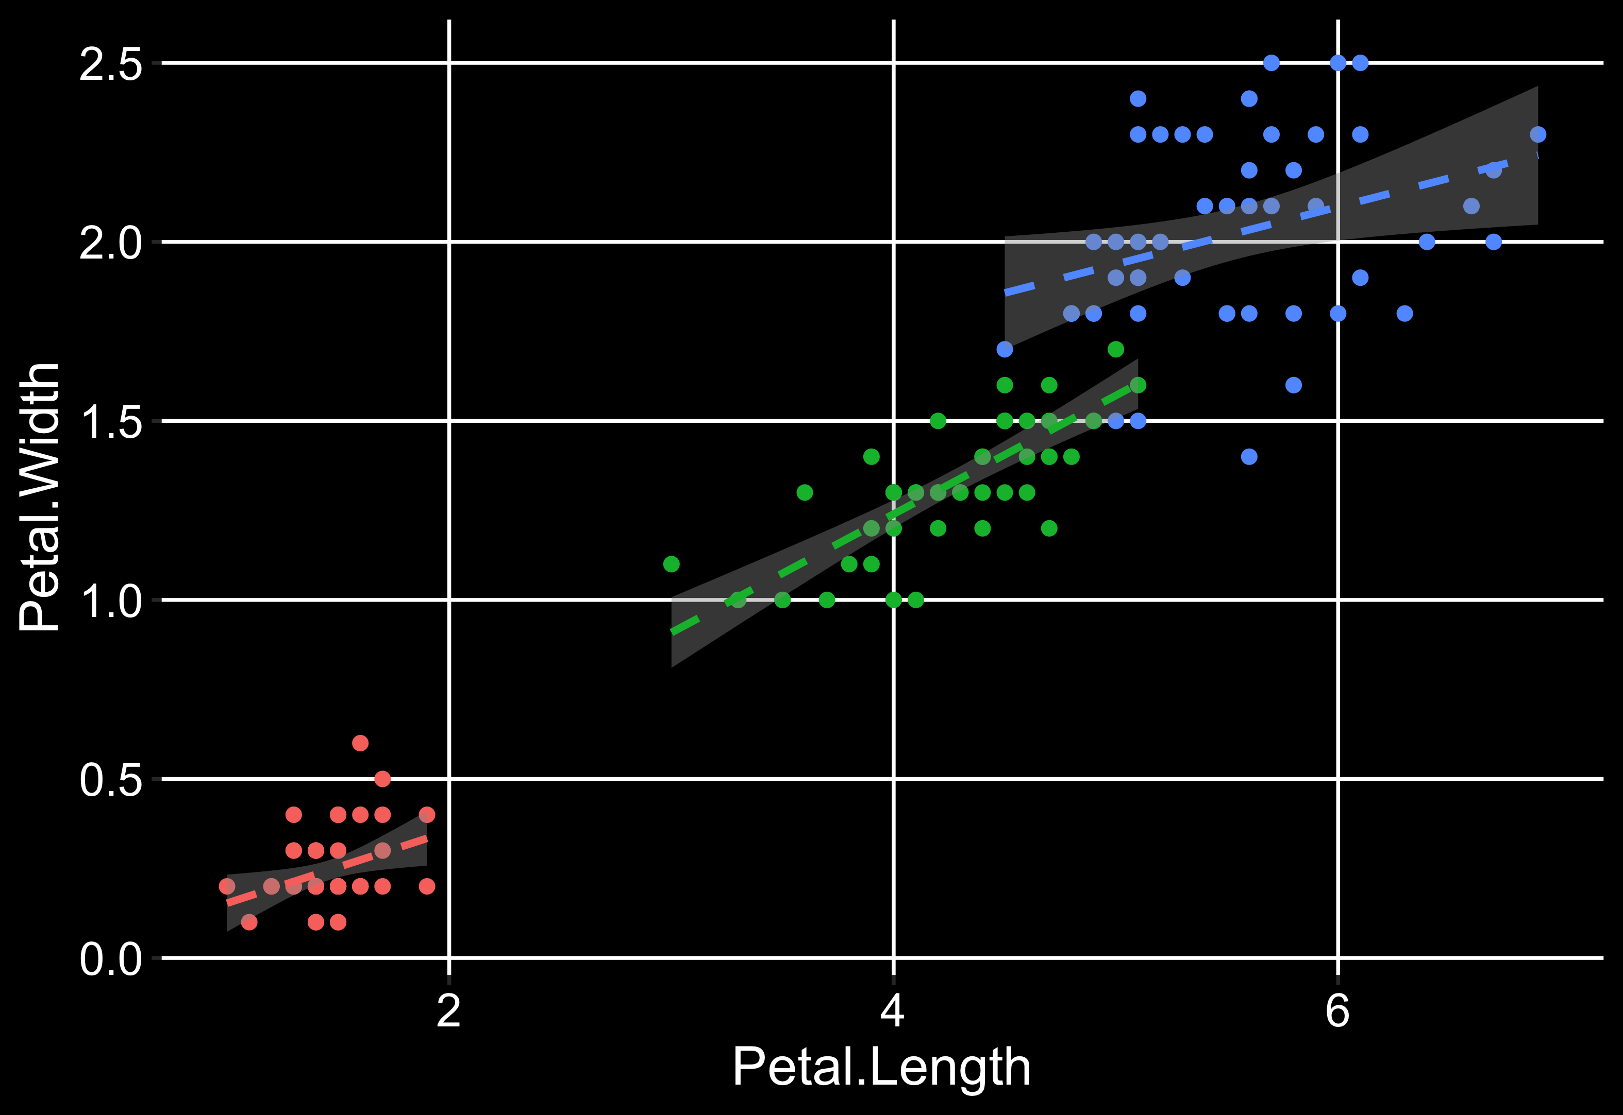
Tips
stat_smooth(data, aes(x, y), method=“lm”, formula=“y~x”, se= TRUE, level=0.95, ...)
Trend line
Just another layer of statistics
ggplot(data=iris, aes(x,y))+ geom_point() + stat_smooth()
ggplot(data=iris, aes(x,y, color=Species))+ geom_point() + stat_smooth()

Slide 33
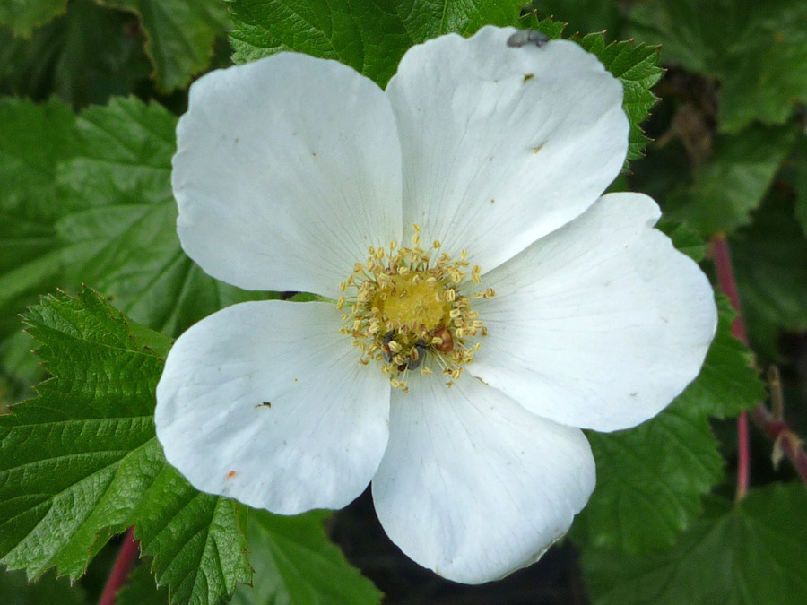
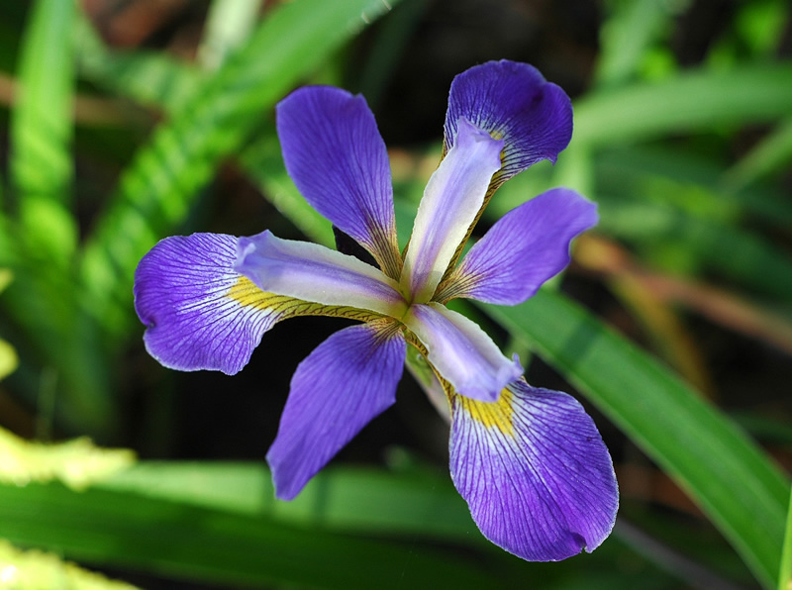
Quiz
Which picture should be Iris?
Reference line
and error bars
ggplot(data=iris, aes(x,y, color=Species))+ geom_point() + stat_smooth()
geom_abline(slope=1, intercept=0)

Slide 34
Quiz
Which picture should be Iris?
Reference line
and error bars
ggplot(data=iris, aes(x,y, color=Species))+ geom_point() + stat_smooth()
geom_abline(slope=1, intercept=0)
geom_hline(yintercept= 0.6)

Slide 35
Quiz
Which picture should be Iris?
Reference line
and error bars
ggplot(data=iris, aes(x,y, color=Species))+ geom_point() + stat_smooth()
geom_abline(slope=1, intercept=0)
geom_hline(yintercept= 0.6)
geom_vline(xintercept= 4)

Slide 36
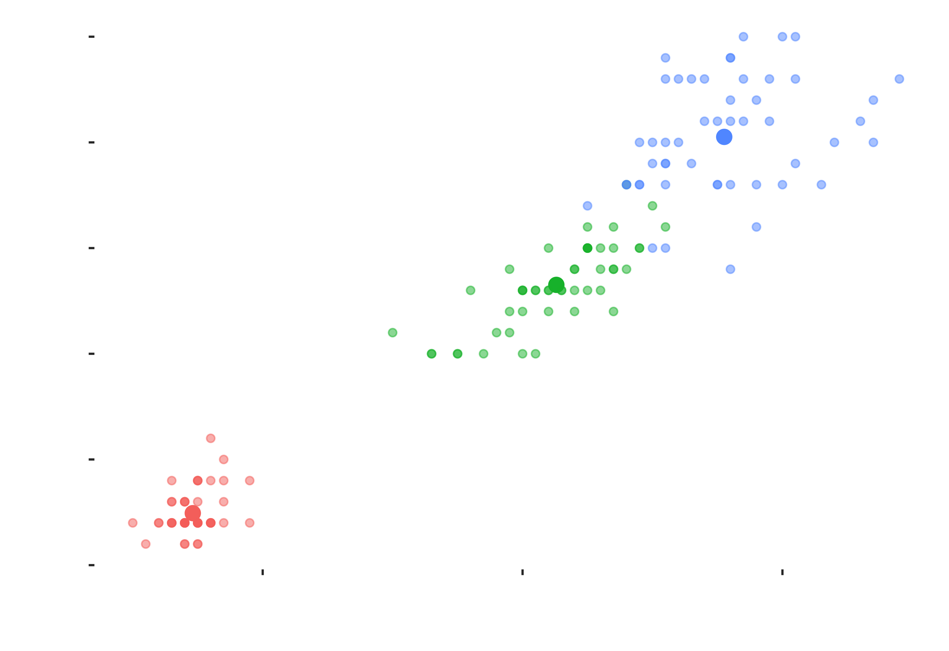
Does the mean value of something differ from another thing?
Reference line
and error bars

Slide 37
Dose the mean value of something differ from another thing?
Reference line
and error bars
Choose error bar
Standard deviation
Standard error
Confident interval
On y axis
geom_errorbar( aes(ymin, ymax) )
On x axis
geom_errorbarh( aes(xmin, xmax) )

Slide 38
Dose the mean value of something differ from another thing?
Reference line
and error bars
Mean + error
Mean - error
On y axis
geom_errorbar( aes(ymin, ymax) )

Slide 39
Summary
ggplot2 can place several graphs
ggplot2 supports build-in and external
on different layers
statistic functions
aes( x= mean(X), y= max(Y) )
stat_smooth( method=‘lm’ )
?stat_summary()

Slide 40

Dealing with
MULTIPLE GRAPHS

Slide 41
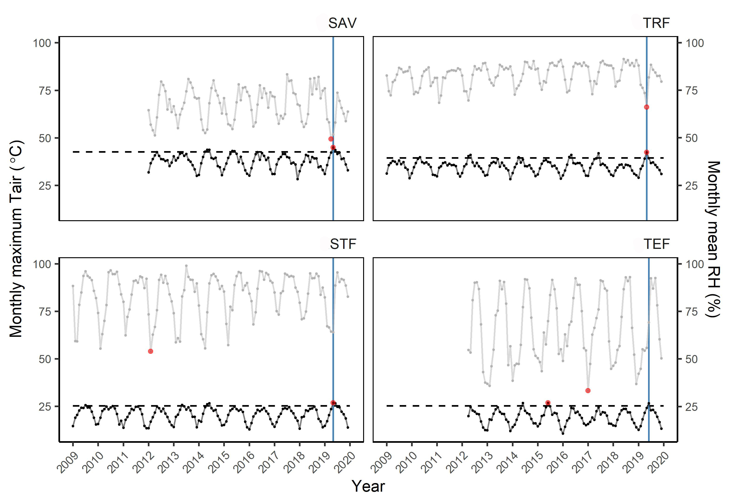
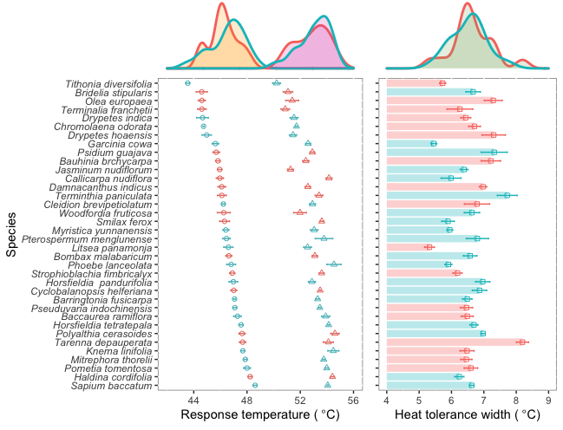
Panel arrangment
Plotting multiple graphs
facet_wrap() or facet_grid()
ggarrange()
> install.packages("ggpubr")
> library(ggpubr)

Slide 42
Panel arrangment
Plotting multiple graphs
facet_wrap() or facet_grid()
> ggplot()+geom_bar()+facet_wrap()
ggarrange()
> p <- ggplot()+geom_bar() +theme()
> q <- ggplot()+geom_boxplot() +theme()
> ggarrange( p, q )

Slide 43
Panel arrangment
facet_wrap() and facet_grid()
They require long format dataset
Year Study site Parameter1 Parameter2
2018 Site1 47.0 59.6
2018 Site2 48.2 60.9
2018 Site3 46.2 61.9
2019 Site1 47.5 60.6
2019 Site2 47.5 61.1
2019 Site3 45.8 64.5
Grouping

Slide 44
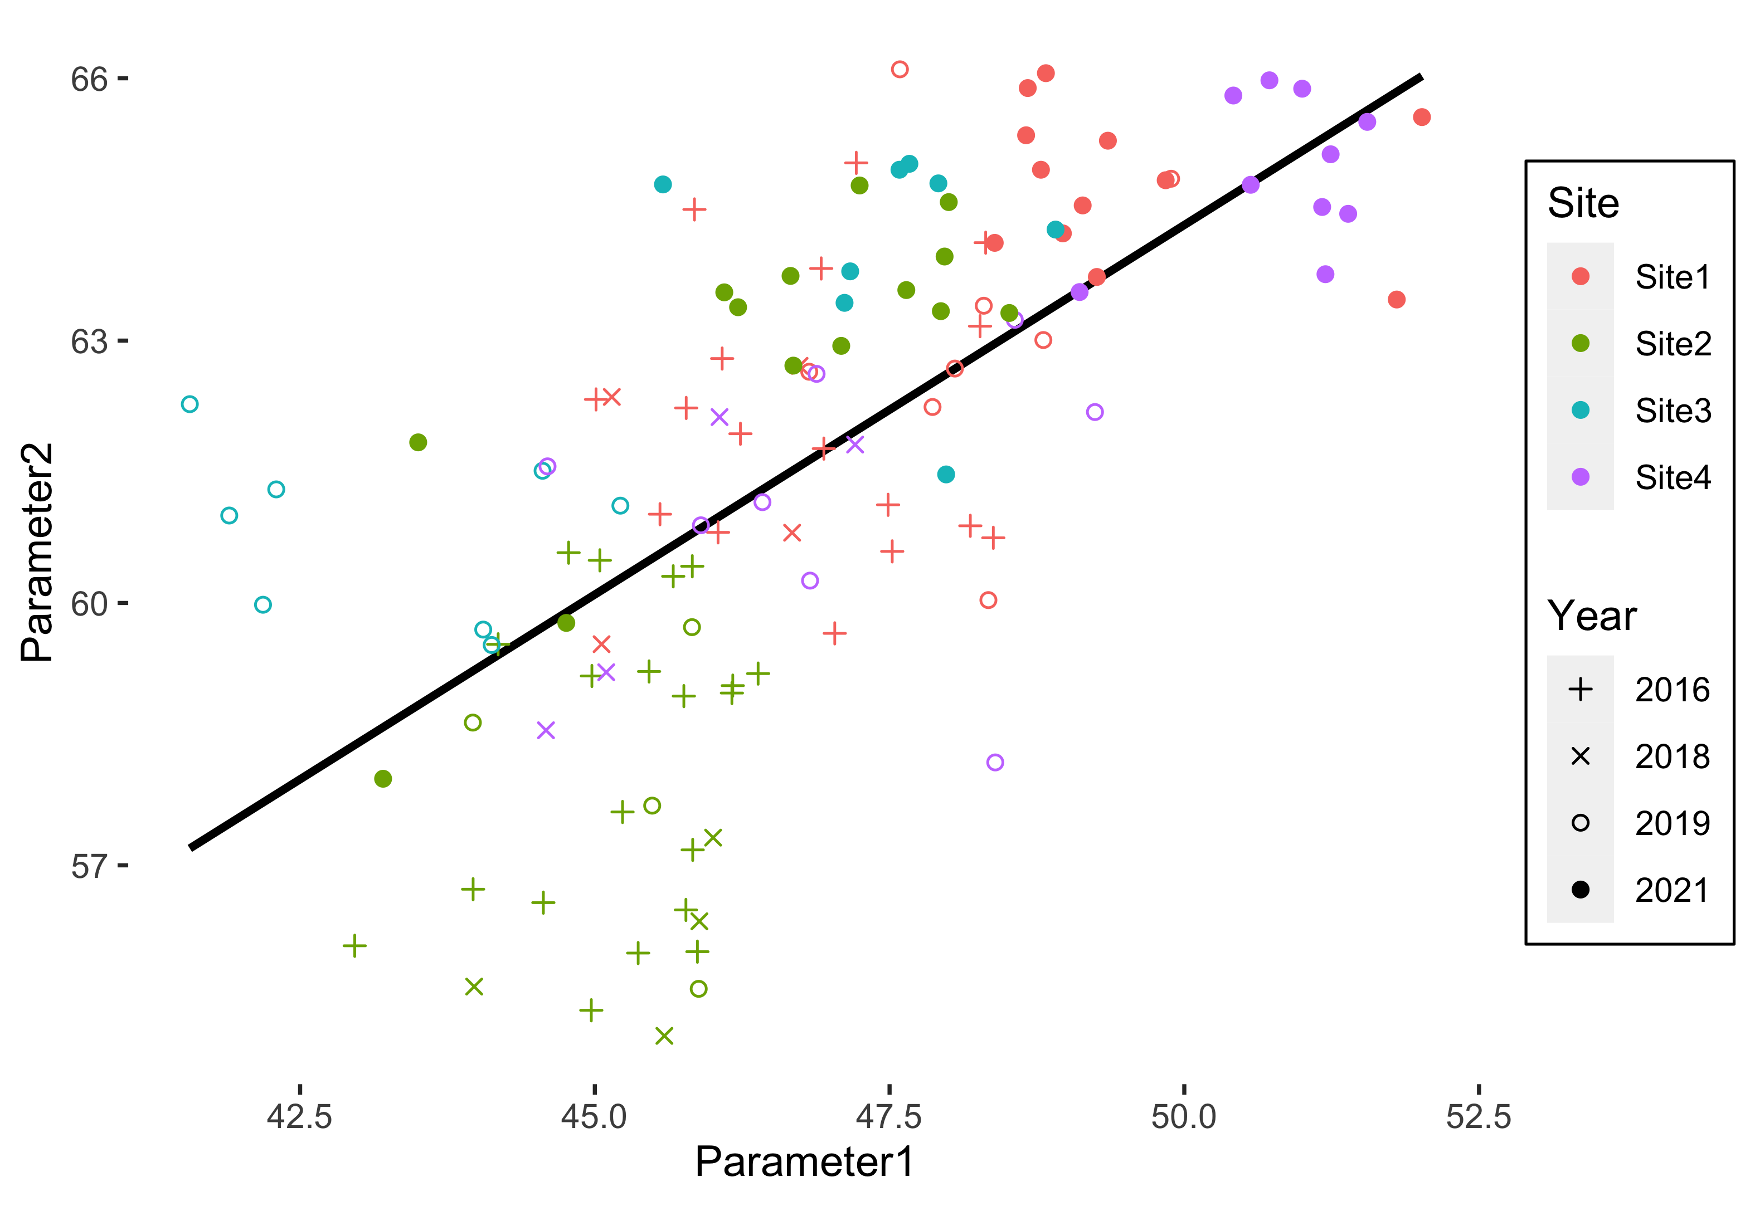
Panel arrangment
facet_wrap() and facet_grid()

Slide 45
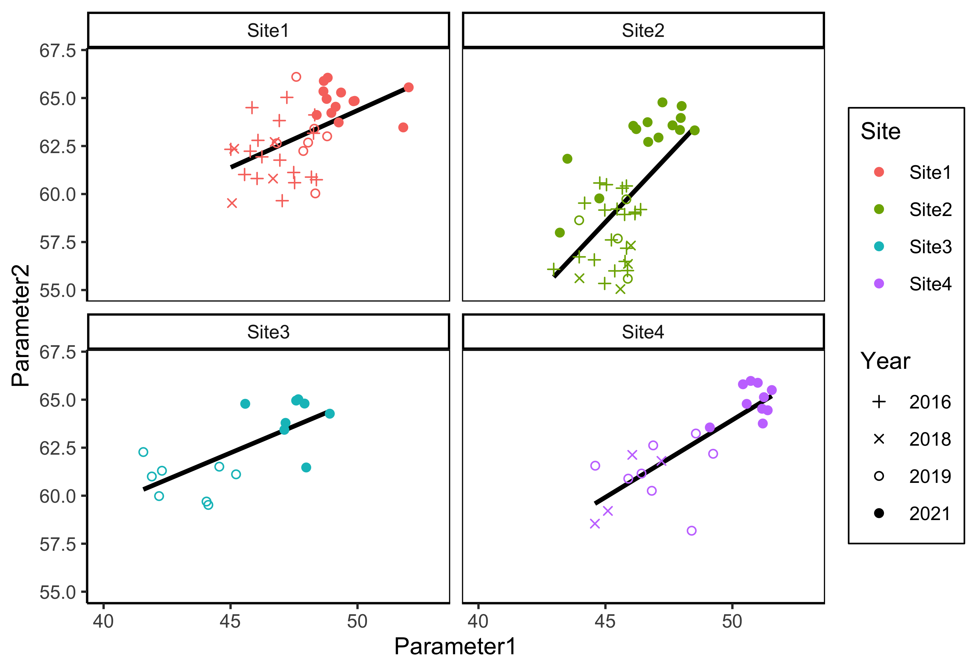
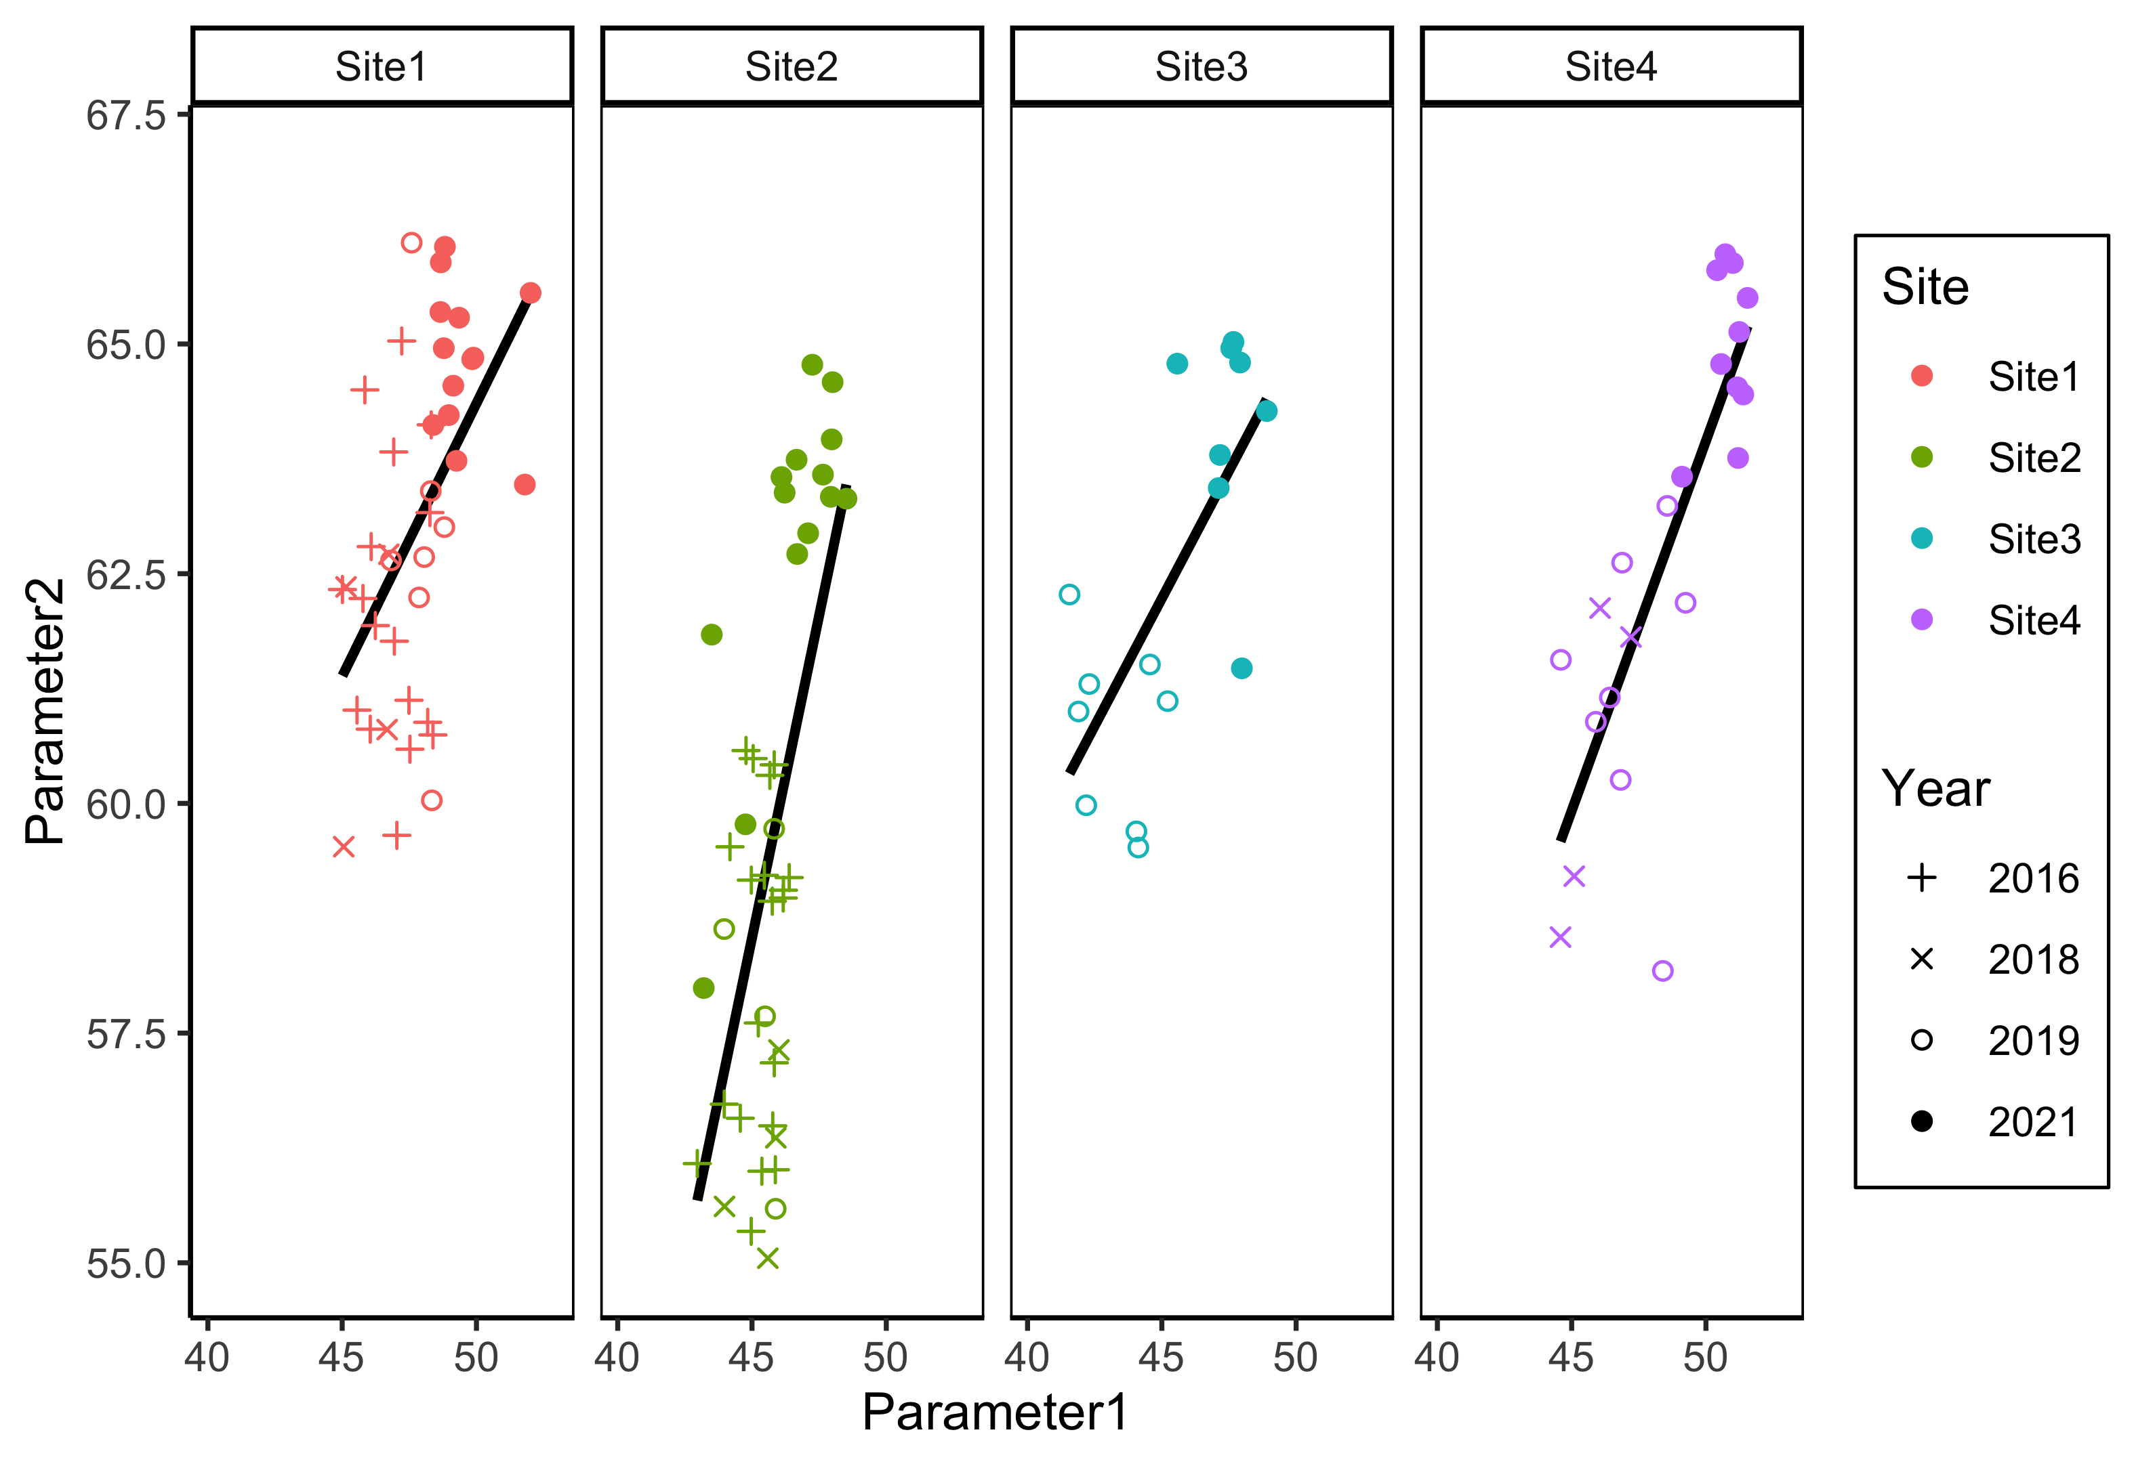
Panel arrangment
facet_wrap() vs facet_grid()
> ... + facet_wrap( ~Site )
> ... + facet_grid( ~Site )
Notes:
facet_wrap() nrow, ncol can be adjusted
facet_grid() nrow, ncol are fixed by vars()

Slide 46
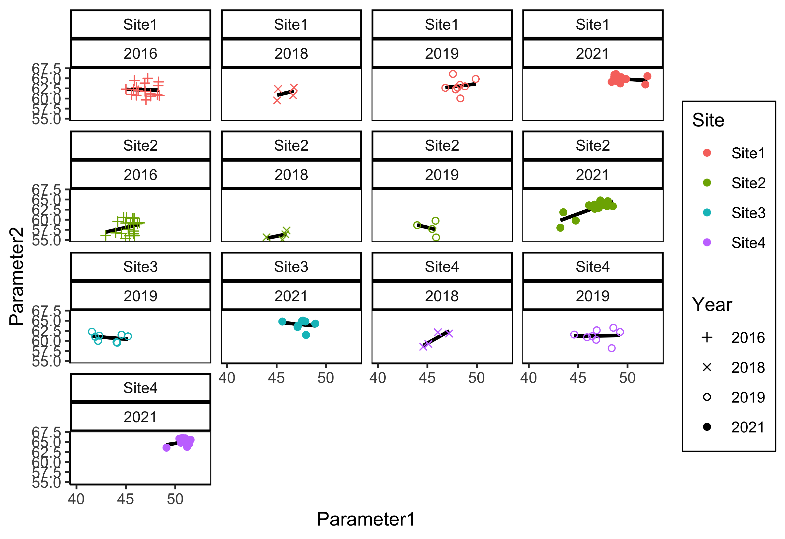
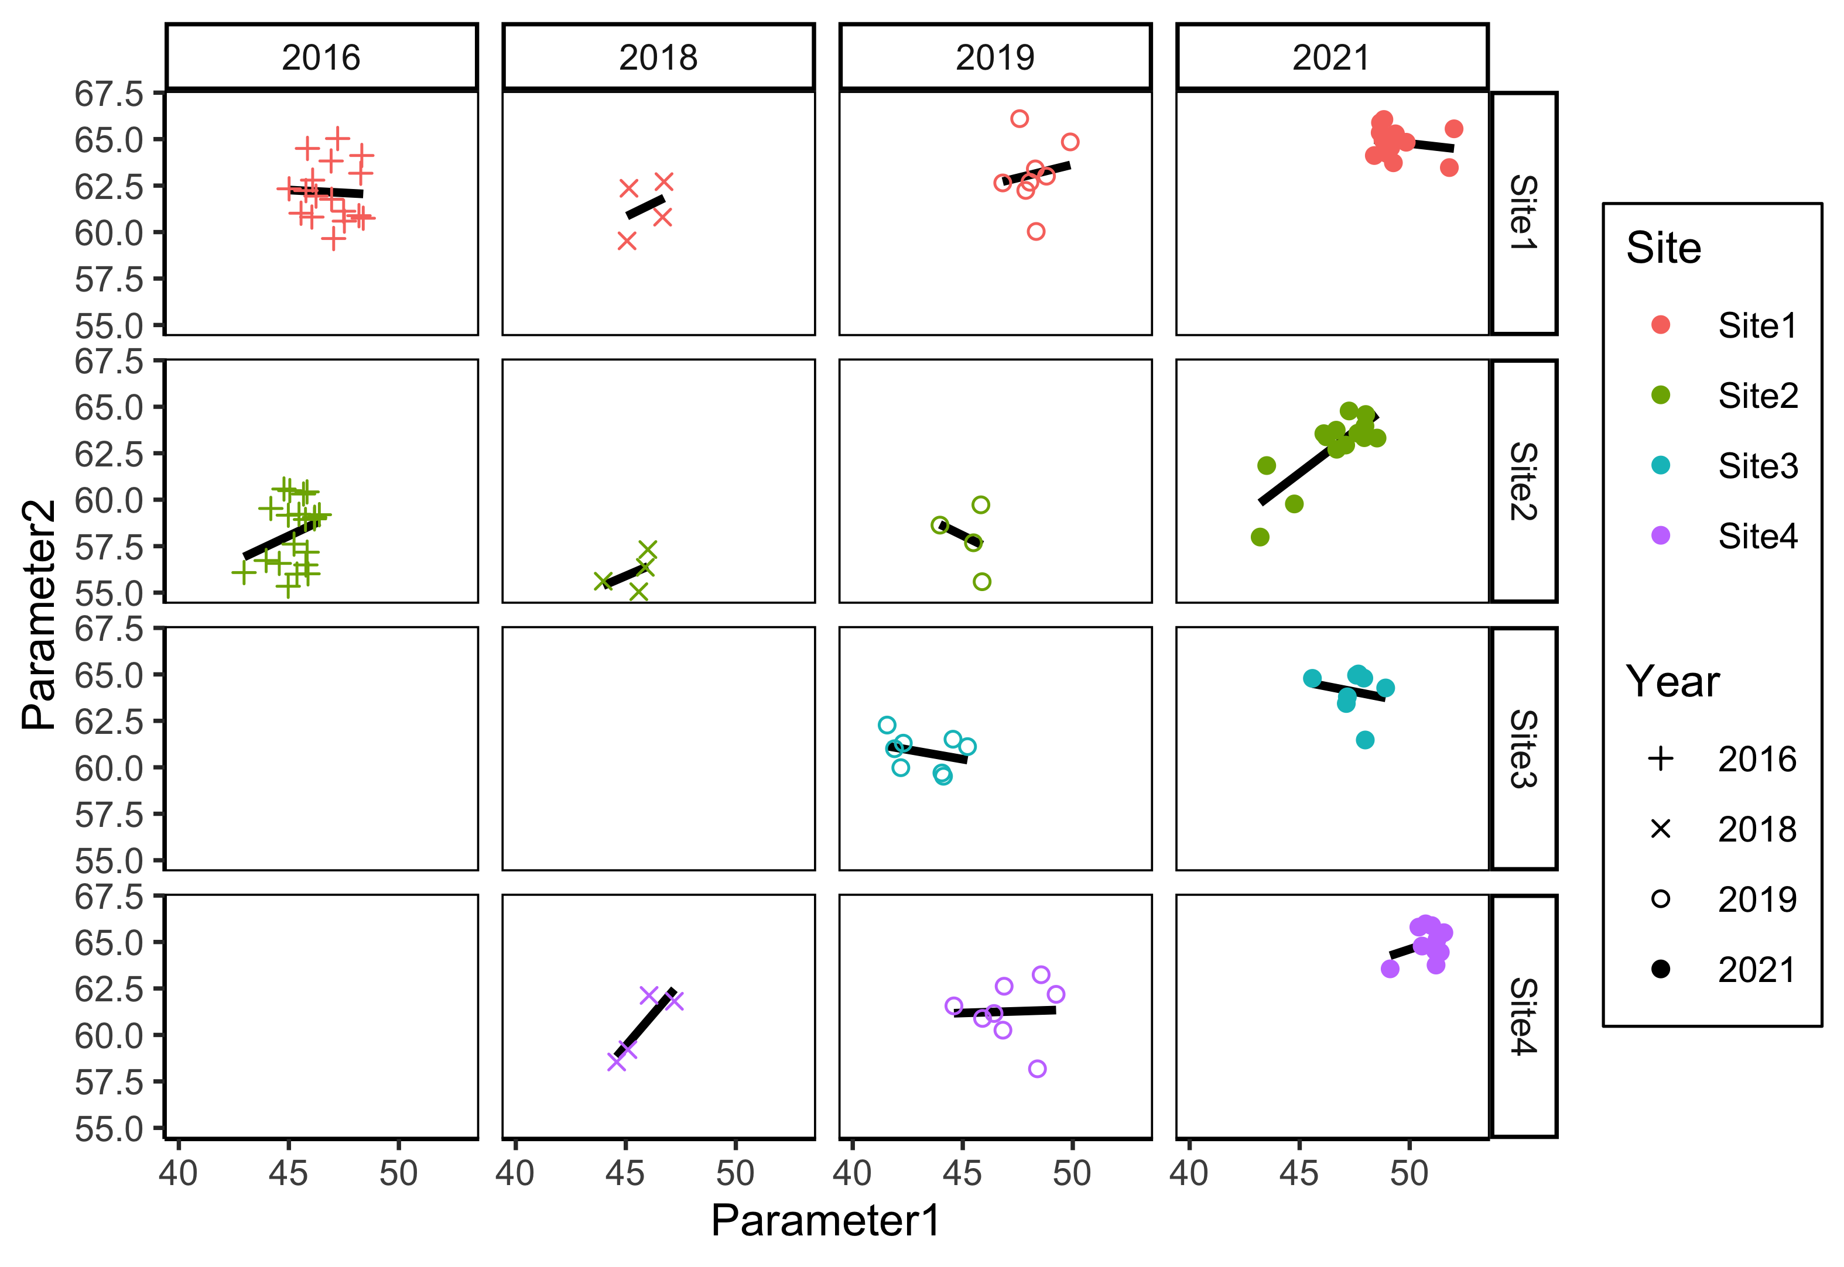
Panel arrangment
facet_wrap() vs facet_grid()
> ... + facet_wrap( Site~Year )
> ... + facet_grid( Site~Year )

Slide 47
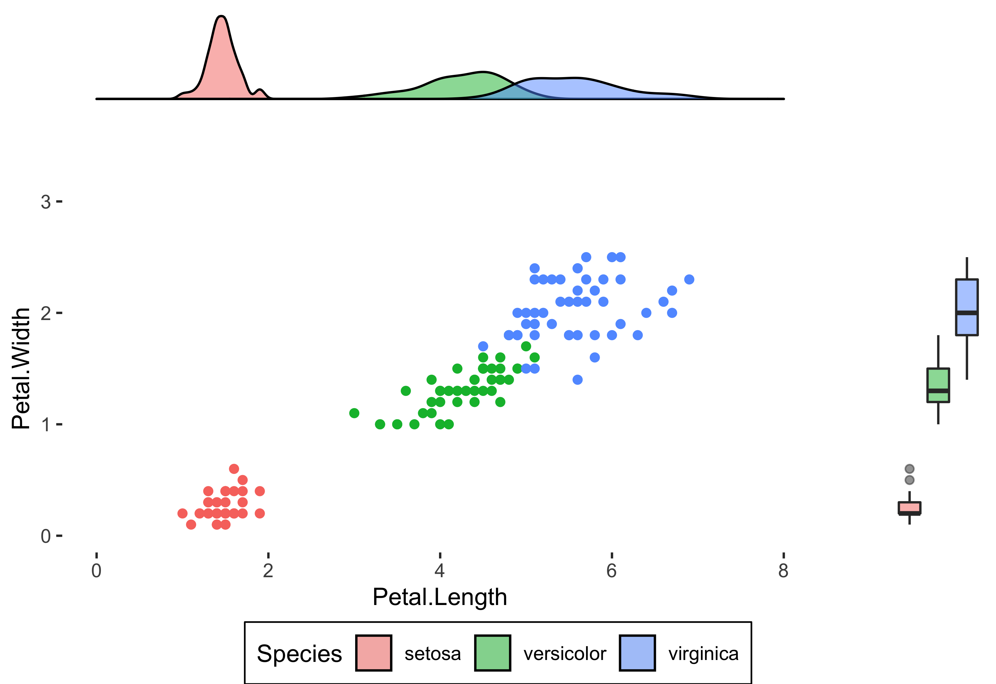
Panel arrangment
ggarrange()
> G1 <- ggplot()+geom_xxx()
> G2 <- ggplot()+geom_xxx()
> G3 <- ggplot()+geom_xxx()
> ggarrange( G1, G2, G3 )

Slide 48
Panel arrangment
ggarrange()

Slide 49
Panel arrangment
ggarrange()
> G1 <- ggplot()+geom_xxx()
> G1
G1

Slide 50
Panel arrangment
ggarrange()
> G1 <- ggplot()+geom_xxx()
> G2 <- ggplot()+geom_xxx()
> ggarrange( G1, G2 )
G1
G2

Slide 51
Panel arrangment
ggarrange()
G3
> G1 <- ggplot()+geom_xxx()
> G2 <- ggplot()+geom_xxx()
> G3 <- ggplot()+geom_xxx()
> ggarrange( G1, G2, G3 )
G1
G2

Slide 52
Panel arrangment
ggarrange()
G4
G3
> G1 <- ggplot()+geom_xxx()
> G2 <- ggplot()+geom_xxx()
> G3 <- ggplot()+geom_xxx()
> G4 <- ggplot()+geom_xxx()
> ggarrange( G1, G2, G3, G4 )
G1
G2

Slide 53
Panel arrangment
ggarrange()
G4
G3
> G1 <- ggplot()+geom_xxx()
> G2 <- ggplot()+geom_xxx()
> G3 <- ggplot()+geom_xxx()
> G4 <- ggplot()+geom_xxx()
> ggarrange( G1, G2, G3, G4 )
G1
G2

Slide 54
Panel arrangment
ggarrange()
G4
G3
G1
G2
> G1 <- ggplot()+geom_xxx()
> G2 <- ggplot()+geom_xxx()
> G3 <- ggplot()+geom_xxx()
> G4 <- ggplot()+geom_xxx()
> ggarrange( G1, G2, G3, G4 )

Slide 55
Panel arrangment
ggarrange()
G4
G3
G1
G2
> G1 <- ggplot()+geom_xxx()
> G2 <- ggplot()+geom_xxx()
> G3 <- ggplot()+geom_xxx()
> G4 <- ggplot()+geom_xxx()
> ggarrange( G1, G2, G3, G4,
widths = c(1,2), heights = c(1,2) )

Slide 56
Panel arrangment
ggarrange()
> G1 <- ggplot()+geom_xxx()
> G2 <- ggplot()+geom_xxx()
> G3 <- ggplot()+geom_xxx()
> ggarrange( G1, G2, G3 )

Slide 57
Panel arrangment
ggarrange()
G1
G2
G3
> G1 <- ggplot()+geom_xxx()
> G2 <- ggplot()+geom_xxx()
> G3 <- ggplot()+geom_xxx()
> ggarrange( G1, G2, G3 )

Slide 58
Panel arrangment
ggarrange()
G1
NA
G2
G3
> G1 <- ggplot()+geom_density()
> G2 <- ggplot()+geom_point()
> G3 <- ggplot()+geom_boxplot()
> ggarrange( G1, NA, G2, G3 )

Slide 59
Functions you have experienced
Major components
Minor components
Optional components
geom_point()
geom_line()
geom_bar()
geom_boxplot()
geom_text()
stat_smooth()
geom_abline()
geom_hline()
geom_vline()
geom_errorbar()
geom_errorbarh()
scale_y_continuous( sec.axis = sec_axis())
facet_wrap()
facet_grid()
ggarange()

